Slide 1
ACME Corp Case Study
Presented by : AASTHA AGGARWAL

Slide 2
Challenges deep-dive
Challenge 1
Challenge 2
Challenge 3
Investigate, Ingest & Clean the Data
Ingest and prepare the data by combining the 10 trans_fact files and replacing any null sales and null units with zero. Perform EDA as required.
Transform & Analyze the Data
Analyze the data to measure how the company is performing.
Summarize your Analysis
Summarizing analysis for the president and his non-technical leadership team and recommending actions that ACME should consider based on the results.

Slide 3
Implementation

Slide 4
Read CSV files and merge 10 transaction files into a single dataset.
Merge diverse data frames. Uncover and analyze company trends using data insights.
Utilize statistical results and graphical representations. Formulate conclusions to drive informed decisions.
Data Collection
Data Cleaning
Data Analysis
Data Visualization
Conclusion
Identify and address NULL values and errors within the dataset.Implement corrective steps to enhance data accuracy.
Develop informative visualizations. Enhance understanding of trends for both technical and non-technical audiences.

Slide 5
Data Cleaning

Slide 6
Important Points
Dimensions of final csv file after merging 10 trans files is (200000,7).
Total number of cells in final csv file that have NULL values is store_location_id:0, product_id:0, customer_id:0, trans_dt:0, sales:616, units:593, transaction_id:0
To not encounter NULL value error while analyzing the data, we replaced NaN values by 0.
After this all columns reportedly have zero NULL values.

Slide 7
Data Analysis

Slide 8
Which row in the final merged file (combining COMBINED_DF and LOCATION) has the maximum and minimum sales?
Firstly, we merged two data frames namely COMBINED_DF i.e. the merged file of all 10 trans files and LOCATION i.e. file containing information about the cities, provinces alongwith store IDs.
Secondly, we used pandas to find the maximum and minimum rows respectively by checking the ‘SALES’ column values.
Results came out to be :
MIN = store_location_id 9807 province ALBERTA city EDMONTON sales -512.68
MAX = store_location_id 9807 province ALBERTA city EDMONTON sales 43533.23

Slide 9
Find top performing provinces and stores.
Firstly, we merged two data frames namely COMBINED_DF i.e. the merged file of all 10 trans files and LOCATION i.e. file containing information about the cities, provinces alongwith store IDs.
Secondly, we used pandas groupby to first group the values according to their sales and then sort the rows respectively returning the province and store IDs with sum of sales.
Results came out to be :
Province = ONTARIO 2183276.40 ALBERTA 1512522.37 BRITISH COLUMBIA 275536.45 MANITOBA 234435.60 SASKATCHEWAN 54711.16
Store= 9807 1030351.77 8142 872304.40 6973 600223.00 1396 467581.28 7296 385435.05

Slide 10
Analyze yearly sales patterns with a graphical representation.
Firstly, we convert ‘trans_dt’ to datetime format and extract the month. The ‘.dt.month’ accessor extracts the month from the datetime and creates a new column 'month' in the DataFrame.
Secondly, we used the .groupby() function to group the data by the 'month' column and then applying the .sum() function to calculate the total sales for each month.
Results came out to be :
1 225892.78 , 2 9446.67 , 3 32365.08 , 4 767716.31 , 5 390961.83 , 6 433594.84 , 7 348517.58 ,
8 551143.66 , 9 371191.32 , 10 399373.14 , 11 354482.10 , 12 375796.67

Slide 11
Analyze seasonal sales patterns with a graphical representation.
Firstly, we convert ‘trans_dt’ to datetime format and extract the month. The ‘.dt.month’ accessor extracts the month from the datetime and creates a new column 'month' in the DataFrame.
Secondly, we used the .groupby() function to group the data by the 'month' column and then applying the .sum() function to calculate the total sales for each month.
Along with grouping data by sales, we also find to which season does the month belong to.
Results came out to be :
Fall 1125046.56 Spring 1191043.22 Summer 1333256.08 Winter 611136.12

Slide 12
Get the top contributing product categories.
Firstly, we merged two data frames namely COMBINED_DF i.e. the merged file of all 10 trans files and PRODUCT i.e. file containing information about the products sold along with their IDs and categories.
Second, we use groupby to aggregate the categories based on the total sum of sales.
Third, we sort the values in descending order to get the top contributing product categories on the basis of total sum of sales.
Results came out to be:
fe148072 57546.44 , ffcec4a7 48485.95 , cef3760b 42988.05 , e49d14f1 38208.15 , 687ed9e3 30999.53

Slide 13
Data Visualization

Slide 14
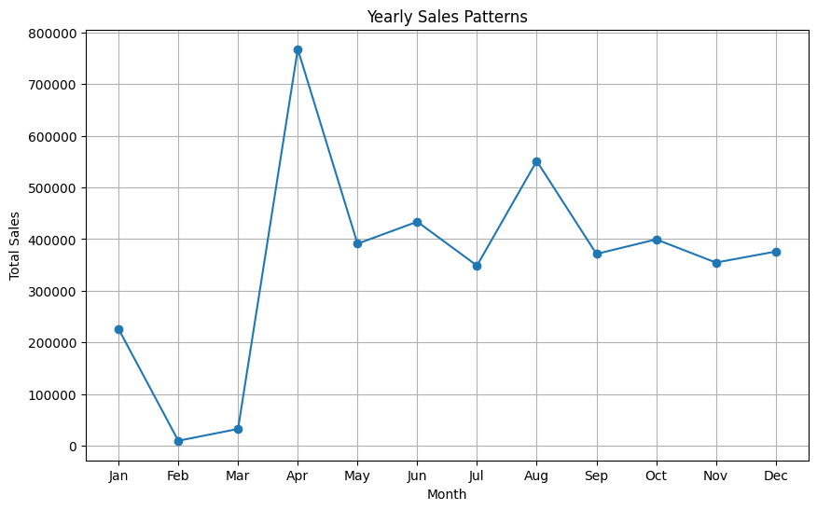
Line Plot for Yearly Sales Pattern.

Slide 15
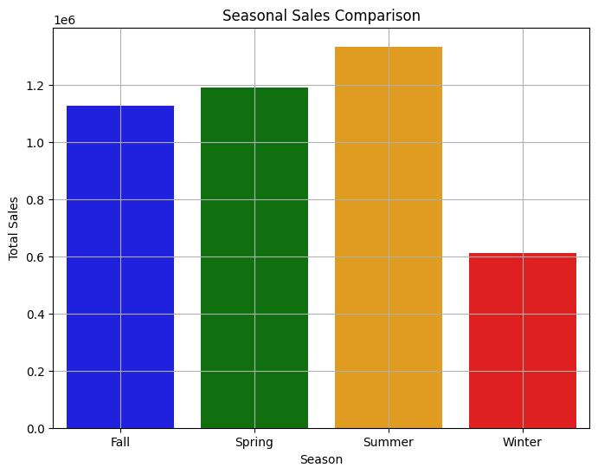
Bar Plot for Seasonal Sales Pattern.

Slide 16
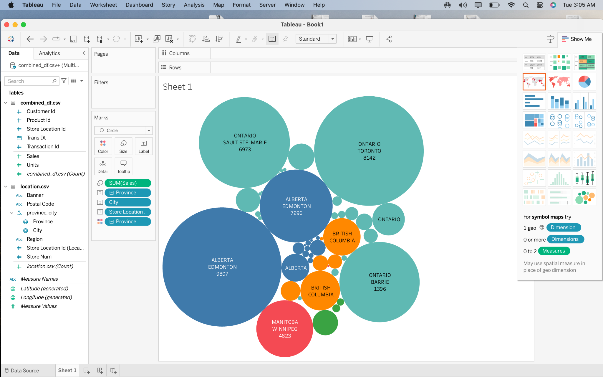
Bubble Plot to show the stores with maximum and minimum sales.

Slide 17
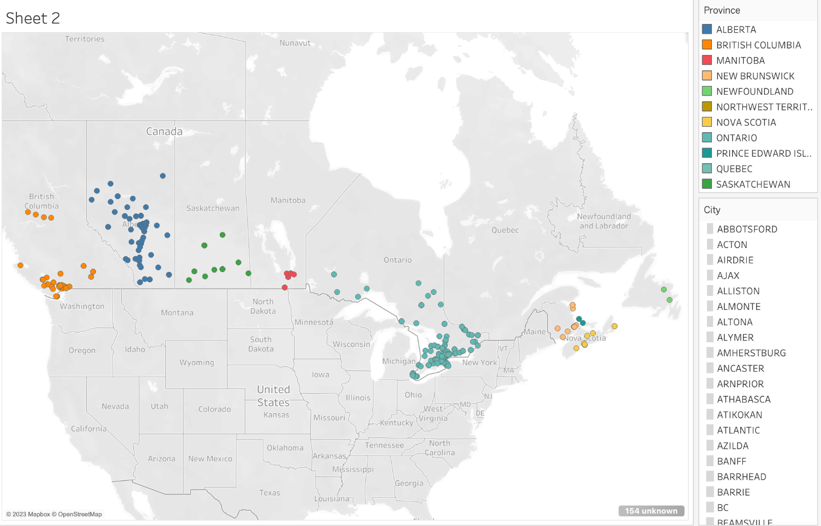
World Map to pinpoint the cities with the number of stores present in them. It covers Canada and many of its important provinces.

Slide 18
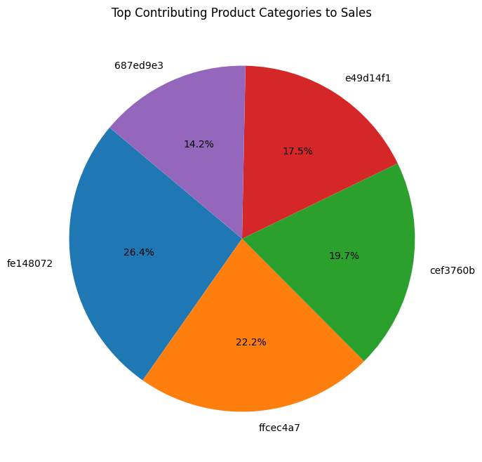
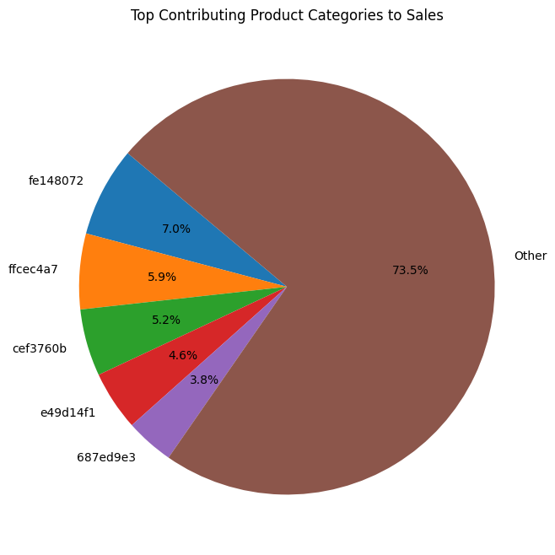
Pie chart depicting the top contributing product categories in ACME's sales.

Slide 19
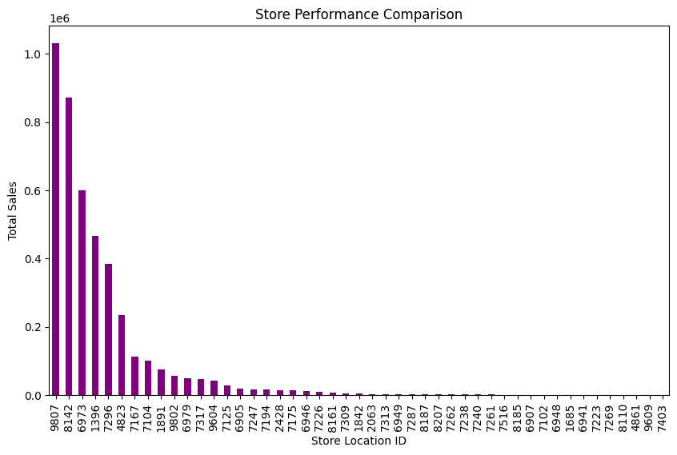
Bar chart comparing different stores across the country based on total sales.

Slide 20
Recommendations based on Data Analysis

Slide 21
Recommendations for ACME Corp
Invest in High-Performing Provinces and Stores: Identify the provinces and stores that are performing well in terms of sales. Allocate additional resources, marketing efforts, and promotions to capitalize on these strong performing areas. Implement strategies to maintain and further enhance their performance.
Promote Top Stores within Each Province: Analyze the performance of the top stores in each province compared to the provincial average. Encourage healthy competition among stores to achieve better-than-average sales. Provide incentives, recognition, or rewards to top-performing stores.

Slide 22
Strategic Product Category Focus: Identify the product categories contributing the most to ACME's sales.Allocate resources towards these high-performing categories, optimizing product offerings and marketing efforts.
Optimize Store Locations and Expansion: Analyze regional and provincial sales distribution to identify underperforming areas. Consider relocating or closing stores in regions with consistently low sales.
Customer Segmentation and Targeting: Utilize customer purchase patterns to segment customers based on their buying behavior.
Continuous Monitoring and Adaptation: Establish a system to continuously monitor sales performance, customer behavior, and market trends. Regularly update strategies and tactics based on changing dynamics and new insights.

Slide 23
To improve low sales in some provinces and stores (shown in bubble plot) :
Investigate which product categories are performing poorly in those provinces/stores.
Research if there are strong competitors in those regions impacting sales.
Evaluate if pricing, product range, or marketing strategies need adjustment.
Explore if there are economic or local factors affecting consumer spending in those areas.
Consider local events, economic downturns, or changes in population demographics.
Evaluate the location of stores in relation to foot traffic, accessibility, and visibility.
Analyze the effectiveness of promotions and marketing campaigns in those regions.

Slide 24
Thank You.

